Slide 1







IOT WORKLOAD CHARACTERIZATION IN NEXT GENERATION CLOUD SYSTEMS UPDATE
Supervised by: Dr. Karan Mitra, Dr. Saguna Saguna,
Dr. Christer Åhlund
Presented by: Fatema Mirza

Slide 2






Introduction
TABLE OF CONTENTS
fatmir-0@student.ltu.se

Slide 3
01
Introduction
fatmir-0@student.ltu.se

Slide 4


IOT EXPONENTIAL GROWTH^{[1]}
There has been an exponential growth of IOT in the past few years and expected to increase.
fatmir-0@student.ltu.se 17/12/2021 | 01
Notes:
The rapid increase in connected device (or IoT device) usage by commercial entities and consumers is changing the topography of the internet Connected devices have been designed to fulfill functional requirements (i.e. observe, control and maintain a piece of machinery remotely), but have often failed at incorporating proper green aspects in their design. The integration of the Internet of things and cloud computing has led to the emergence of new classes of applications ranging from smart healthcare, smart and precision agriculture, smart manufacturing to smart environmental monitoring. The rapid surge in the use of these applications is expected to generate massive amounts of data with different characteristics that are yet not studied.

Slide 5




01
03
IOT USAGE IN ^{[2]}…
02
04
Smart Healthcare
Smart Manufacturing
Smart Agriculture
Smart Environmetal Monitoring
fatmir-0@student.ltu.se 17/12/2021 | 02

Slide 6

Problem Statement
We hypothesize that each IoT-enabled application may exhibit a diverse range of characteristics that if modelled correctly, may lead to efficient distributed systems. This thesis aims to study the traffic characteristics of an IoT-enabled healthcare application to build intelligent policies for efficient scalable IoT-cloud systems.
fatmir-0@student.ltu.se 17/12/2021 | 06

Slide 7
RQ2.
RQ1.
Research Questions
RQ3.
What are the traffic characteristics of an IoT?
What analytical model best approximates IoTHA traffic?
How do we integrate green elastic policies into IoTHA?
fatmir-0@student.ltu.se 17/12/2021 | 11

Slide 8
02
Meeting the research questions
The challenges, definite problem, and the hypothesized solution
fatmir-0@student.ltu.se

Slide 9
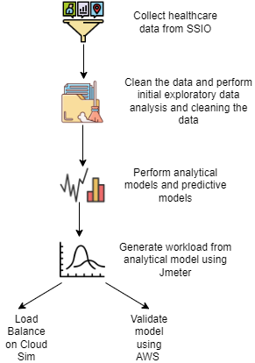
Work Flow
fatmir-0@student.ltu.se 17/12/2021 | 11

Slide 10
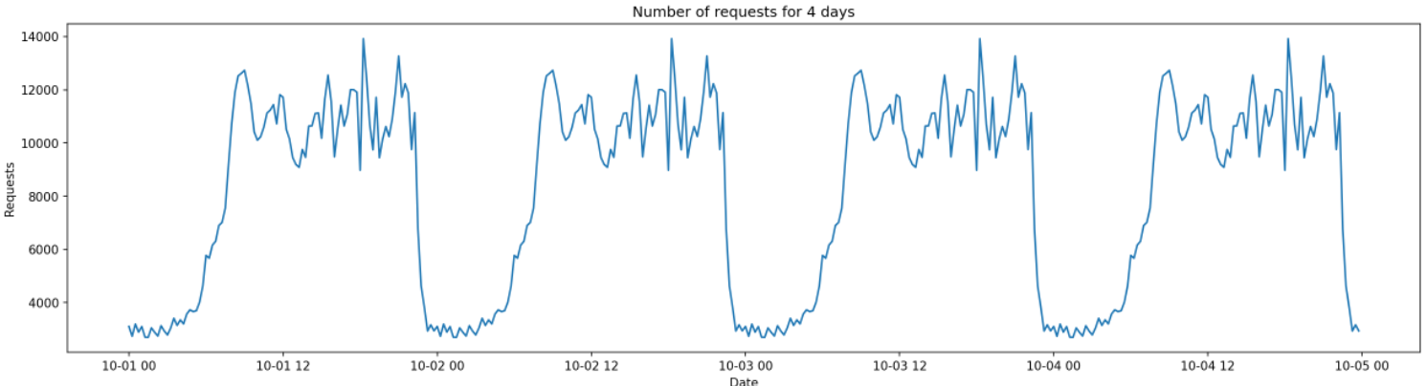
ARIMA or SARIMAX?
Dataset was modelled at 15 minutes granularity.
Dataset for 4 days where 3 days will be used as training and the 4th day will be used as testing.

Slide 11
ARIMA or SARIMAX?
ARIMA gives good results, but with changing the dataset as such for 4 days, a seasonality is added (repeats every day) which helps in prediction even further, especially with sliding window of 1 hour.

Slide 12
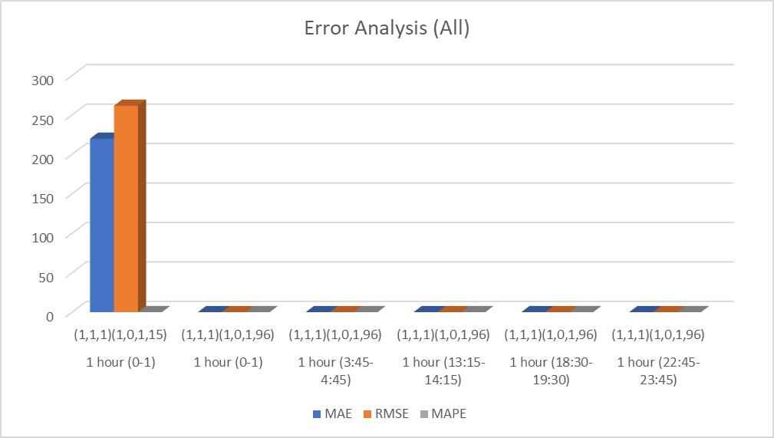
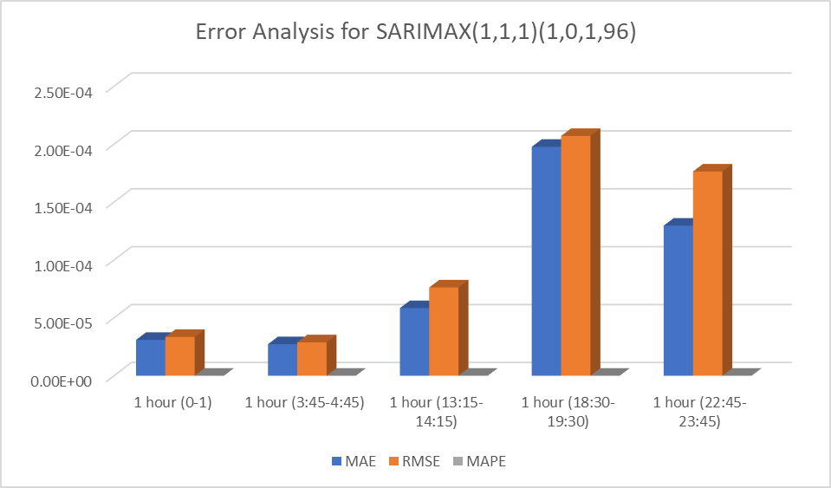
ARIMA or SARIMAX?

Slide 13
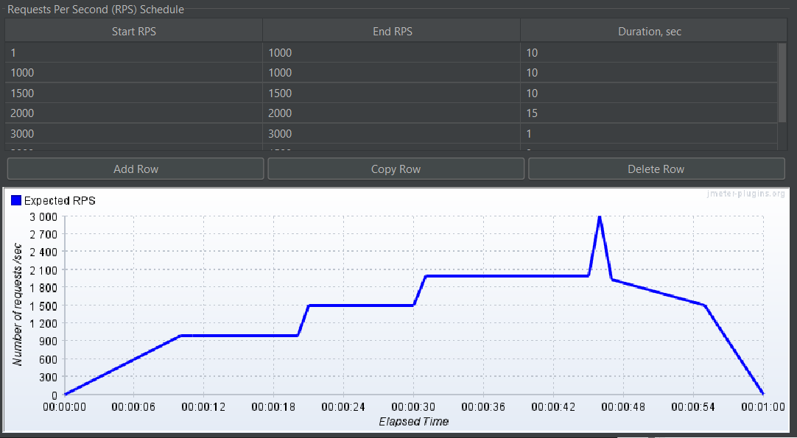
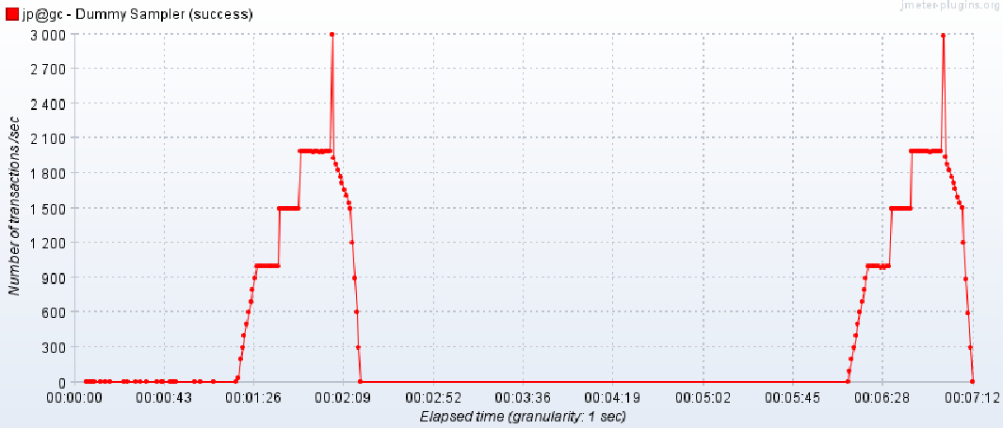
Jmeter Custom Load Generate
Thanks to the authors of A Hybrid Mechanism of Horizontal Auto-scaling Based on Thresholds and Time Series who replied to my frantic emails, I figured out how to custom load generate. The graphs below is only for demonstration purpose.
Load specified
Load successfully generated (twice)

Slide 14
Options …
A. Load could be generated using Jmeter and specifying the requests per seconds. (The idea is taken from the paper A Hybrid Mechanism of Horizontal Auto-scaling Based on Thresholds and Time Series)
B. The base value for each 15 minute of simulation will be obtained from the corresponding 15 minute in the workload traces. This value will be divided by 15 to define the base number of average requests per minute for that 15 minute. Within each 15 minute, requests that will be submitted at each minute, following a Poisson distribution using the base number of requests/min for the 15 minute as the average. Each request is modeled to require 50 ms with a positive variation of 10%, uniformly distributed. (The idea is taken from the paper Workload Prediction Using ARIMA Model and Its Impact on Cloud Applications’ QoS)

Slide 15
ARIMA or SARIMAX?
Dataset for 4 days where 3 days will be used as training and the 4th day will be used as testing.

Slide 16
ARIMA or SARIMAX?
ARIMA gives good results, but with changing the dataset as such for 4 days, a seasonality is added (repeats every day) which helps in prediction even further, especially with sliding window of 1 hour.

Slide 17
ARIMA or SARIMAX?

Slide 18
Simplified Idea
1. Create a program on an EC2 instance named LBServer which will contain the program that will predict the upcoming workload for 1 hour
2. Based on a threshold (set upon using experiment), if the predicted workload is above a certain level, this will trigger the instantiation of a new instance 30 minutes before it is required. Based on the size of the workload, different types of instances can be selected.
3. Based on a threshold (set upon using experiment), if the predicted workload is below a certain level, this will trigger the shutting of a selected instance 30 minutes after it is required.
4. Set up either AWS autoscaling algorithm or round robin algorithm to compare the proposed algorithm

Slide 19
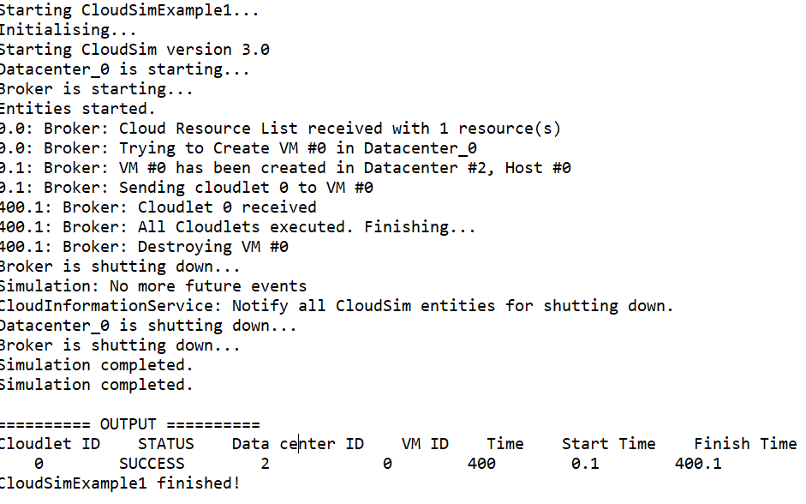
CloudSim

Slide 20
Next Steps
Perform load balancing on CloudSim according to our idea and then validate with AWS

Slide 21
fatmir-0@student.ltu.se 17/12/2021 | 15

Slide 22

Thank you! Tack så mycket
Any Questions?
fatmir-0@student.ltu.se

Slide 23
